Slide 1



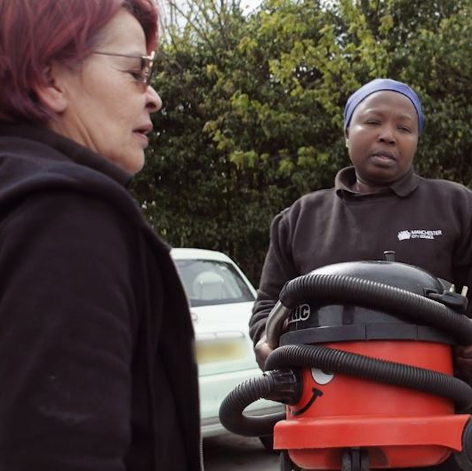

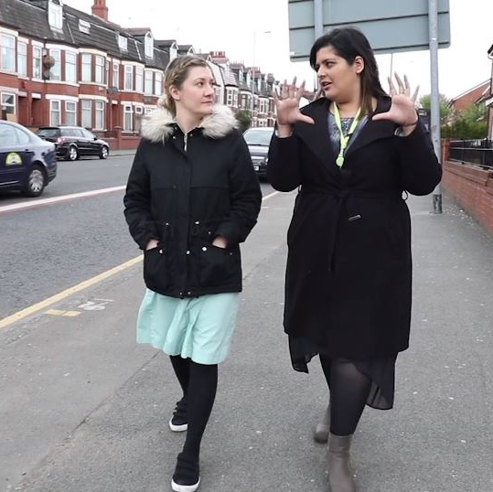



Introducing Manchester Local Care Organisation and the Integrated Neighbourhood Team approach

Slide 2
MLCO in simple terms
MLCO is the public sector partnership organisation that provides the city's NHS Community Health and Adult Social Care services.
We're part NHS and part local authority. Over 2,200 NHS adults and children's community healthcare and 1,800 adult social care staff and the services they provide are formally deployed as part of MLCO
They include district nurses, social workers, health visitors, community dentists, therapists, school nurses, reablement teams, rehabilitation teams, intermediate care, end of life care, disability supported accommodation staff and many other health and care professionals and support teams
MLCO brings these staff together as one team to provide better care to the citizens of Manchester, keeping people well in the community and out of hospital
To do that we work in partnership with GPs, mental health, the voluntary sector, other partners - and most importantly, the people who live in the city.

Slide 3


Formed in 2018 as a partnership organisation
Based around 12 neighbourhood teams
The intention of MLCO is to integrate community health, adult social care, population health and contracting for care - working closely with primary care.
The partners who make up MLCO are Manchester University NHS Foundation Trust, Greater Manchester Mental Health, Manchester City Council, Greater Manchester ICB and the Manchester Primary Care Partnership.
Most of our staff are deployed from Manchester University NHS FT and Manchester City Council. A Section 75 agreement is in place with the local authority to do this.
Our neighbourhood approach sees health and social care staff working together and co-located in the communities they serve.
We have 12 Integrated Neighbourhood Teams - each serving populations of between 30-50k people.
As well as delivering day to day services from their hub in the neighbourhood, the INTs have a role in working with local people to improve health and wellbeing in the neighbourhood.
It's a model based on international best practice.

Slide 4












Our vision and four key ways of working
Our vision at MLCO is:
Working together we can help the people of Manchester:
Have equal access to health and social care services
Live healthy, independent, fulfilling lives
Be part of dynamic, thriving and supportive communities
Have the same opportunities and life chances, no matter where they live
Receive safe, effective and compassionate care, closer to their homes
We all work to make our vision happen by:
Promoting healthy living
Keeping people well in the community
Building on vibrant communities
Supporting people in and out of hospital
Every member of the LCO team, in community health and adult social care, play a part in this through the work they do every day.

Slide 5

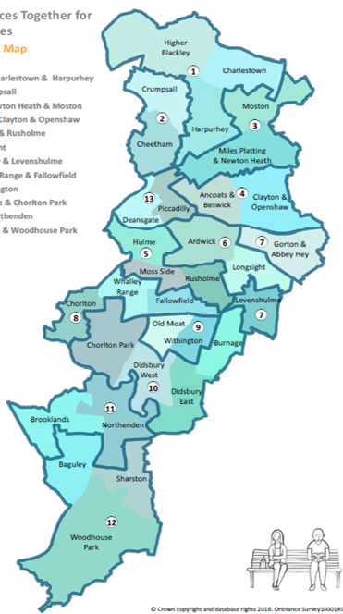
Why a neighbourhood approach?
Manchester's neighbourhoods
Higher Blackley, Charlestown & Harpurhey
Cheetham & Crumpsall
Miles Platting, Newton Health & Moston
Ancoats, Beswick, Clayton & Openshaw
Hulme, Moss Side & Rusholme
Ardwick & Longsight
Gorton, Abbey Hey & Levenshulme
Chorlton, Whalley Range & Fallowfield
Old Moat & Withington
Didsbury, Burnage & Chorlton Park
Brooklands & Northenden
Baguley, Sharston & Woodhouse Park
City Centre
We believe that organising health and social care service delivery on neighbourhood footprints creates opportunities for frontline staff to work together in places and achieve our vision:
To improve the quality and integration of services and the extent to which they are joined up around residents/patients
To reduce duplication of visits and ensure residents and patients are in control of the care for them
To create opportunities to support residents prevent ill health
To support residents to be independent, as well as possible, in control, and connected to their communities.
MLCO currently work on a 12 integrated neighbourhood team footprint with the City Centre combined with neighbourhood 3.

Slide 6
Our vision for neighbourhood working in Manchester
Our shared principles of neighbourhood working
Working together across Manchester to support people and their families to live the healthiest lives possible and receive the right care where and when they need it.
Neighbourhoods where people and communities are actively supported to help themselves and each other
More support for residents and their families to get healthy, stay well, keep safe and be as independent as possible
A life course approach which encourages multi-agency working across for children, families and adults
Addressing the wider social and economic determinants of health for all of the population - reducing inequalities in outcomes
Joined up and personalised care that meets the physical, mental, social and related needs of residents and families
High quality GP practices, pharmacies & community Health and Social Care services offering people more support closer to home
High quality hospital and other institutional care (e.g. care homes) for when people when they need them.
Across the Manchester system by working together we will:
Adopt an asset-based approach across all our teams within Neighbourhoods so that we start with recognising the things that people and places have and gain an understanding of what a good life means for them.
Work together to build strong and cohesive local Neighbourhoods where there is a focus on people and communities supporting each other alongside a vibrant and diverse set of services that people can access.
Empower our staff to support people in ways that work them with clear responsibility. Staff are not constrained by professional and organisational boundaries and work together to respond to resident needs. Person, family and Neighbourhood first not organisation first.
Start by listening to what is important to residents within each Neighbourhood as well as using local intelligence to help identify the outcomes and priorities that we want to change.
Support each Neighbourhood to determine its own priorities which will influence where we all focus our efforts.
Recognise and value the important contribution of the voluntary and community sector in improving health and wellbeing and they will play an important leadership role in Neighbourhoods.

Slide 7
A population health management approach
1. Understanding the needs of Neighbourhoods as a whole (people and place)
Neighbourhood teams supported by evidence-based information to understand the current and future needs & priorities within individual Neighbourhoods
This approach supports people during their life course and according to level of complexity and need. What is important to make this approach work:
Engagement of residents within the Neighbourhood to help determine priorities
Staff empowered to work together with people using a strengths based approach – recognising the importance of loneliness and social isolation. A comprehensive community navigation offer to support prevention and early intervention.
Strong analytical skills and expertise in population health management underpinned by linked data / dashboards which help to understand the needs of local populations and places. This includes understanding the role of the wider determinants of health, outcomes for individuals and families and how Neighbourhoods will change over time e.g. housing and public realm developments.
Enhanced and aligned MDT working across Manchester that is better supported, has a clearer structure and purpose, is effective at identifying the right people and determining the right interventions for individuals.
Embedding a pathway approach which identifies what is important for the patient, what their needs are and how support can be better accessed
Residents who are involved from the outset – they are involved in making decisions about their own care and support so that care is personalised and coordinated.
2. Understanding the needs of specific groups or cohorts of the Neighbourhood
It will be important to identify specific groups of the population where support will have the greatest impact, informing service delivery. This includes whole population prevention
3. Identification of individuals and families that would benefit from multi-disciplinary support
Information (data alongside professional and other local knowledge) used to identify specific individuals for discussion at Neighbourhood MDTs (anticipatory care)
4. Personalised and coordinated care and support which puts the person at the centre
Coordinated response from Neighbourhood MDT team. Trusted assessment & integrated care processes supporting.

Slide 8

The MLCO operating model
Sources of care from Manchester Local Care Organisation
Population need
Enhanced offer to top 0-5%
INT multi disciplinary team (MDT) led offer
INT MDT led offer
MCR/ urgent community offer
Community health and social care services (adults and children)
VCSE and community assets
Mental health
Prevention programme
Same day urgent care offer to all residents
Universal access
Self care
Community assets
Primary Care
0-5% of population with most complex needs and at risk
Supporting people in/out
of services
15% high risk and rising risk
Keeping people well in the community
40% medium risk and/ or regularly accessing services
Building on vibrant commmunities
40% healthy and accessing services as and when needed
Promoting healthy living
NHS Community, Primary Care, Adult Social Care and Mental Health services working through MLCO across all services.
Our four key ways of working
*INT = Integrated Neighbourhood Team. MLCO's 12 integrated health and social care teams across the city serving populations between 30-50k.
*MCR = Manchester Community Response. MLCO's range of health and social care short term intervention, crisis and support services to avoid hospitalisation.

Slide 9
Integrated care through the operating model
MLCO delivers integrated community services to all residents of Manchester of all ages. The model ensures full population coverage through:
Risk stratification: our model identifies those residents who are in the key priority cohorts and we are working as part of a system-wide group to develop a consistent approach to risk stratification.
Aligned data and intelligence: partners across the city are working together to ensure we share our data and intelligence to support our service planning and delivery
Neighbourhood Partnerships and plans: enabled the development of 12 integrated health and social care neighbourhood plans documenting the consistent actions in all neighbourhoods and the key actions in each place to address specific inequalities and needs, through the alignment of the data and intelligence across Manchester. In 21/22 they will be aligned to the ward and PCN plans and support our understanding of our joined up approach in the place
Locality (North, Central and South Manchester) Partnerships and Ops Boards: support coordination of activity across our neighbourhoods to ensure full population coverage and those communities that would identify wider than our neighbourhoods.
Supporting people in/out
of services
Keeping people well in the community
Building on vibrant commmunities
Promoting healthy living

Slide 10


Unplanned and planned care approaches through the model - one team with different approaches based on need
Unplanned care
Planned care
Manchester Community Response
Our umbrella service for short term care in the community to keep people out of hospital
Crisis Response Team (Admission Avoidance)
Discharge to Assess Pathways (Referrals from hospital wards)
Community Flow (MCR representation at hospital sites)
Social care Reablement
Intermediate care - home and bed based
Integrated Discharge Team
Being established in each locality and located in the hospitals
Managing flow with practitioners as part of the acute service delivery teams for Manchester Residents.
Integrated Neighbourhood Teams
12 Integrated Neighbourhood Teams (INTs) district nurses, therapists, reablement, social care staff, co-located in community hubs; providing specialist and / or multi-disciplinary services.
Monthly MDTs and weekly Multi-agency meetings (MAMs) in each neighbourhood; supporting the MDT approach
Coordinated Care Pathway standardises INT offer; facilitated by Care Navigators; support mobilisation of social prescribing
Neighbourhood bi-monthly Partnership meeting engages wider community in the design and delivery of the things that matter to them.

Slide 11


People flow in neighbourhood services:
Coordinated care pathway
People with most complex needs
Principles
no wrong front door
keeping ‘referrals’ to a minimum
different roles, shared competencies
INT team services
MDT Meetings - monthly at GP practice
Multi-Agency Meetings - weekly in Neighbourhood (health, social care, pharmacy, reablement, housing etc)
Need a second look?
Care Navigators – referring into VCSE, peer groups, housing, Citizens Advice Bureau
Social prescribing, broader prevention activities
People with least complex needs

Slide 12

INT Teams for heath and social care
The Core Neighbourhood Team is consistent across all 12 Neighbourhoods
They are a multi-disciplinary, multi-agency team working closely together whilst maintaining links to employer/ profession. Matrix line management model
Voluntary sector play an important role in multi-agency working including MDT involvement in Neighbourhoods and co-opted leadership roles in some areas
The team are co-located in the Neighbourhood. This is predominantly to support Multi-Disciplinary Meetings and co-working space
The team adopt a strengths/asset based approach focusing on prevention and recognising the importance of the social determinants of health.
Each of the 12 INTs has
INT Lead
Links to GP practices in neighbourhood and Primary Care Network/s
GP Lead
Adult Community
Nursing Lead
Co-located community health and adult social care teams
Adult Social Care
Lead
Health Development Coordinator
Care Navigator
Voluntary sector representation from the neighbourhood
*Representative from mental health trust

Slide 13
Bringing services together for people in places
- Team Around the Neighbourhood (TAN)
Manchester City Council Neighbourhoods
Greater Manchester Police
Health and Social Care (MLCO)
We recognise that the health and wellbeing of residents, and the demand for Health and Social Care services, is significantly dependent on the contribution of other public services
Integrated Health and Social Care services are one part of the neighbourhood approach across the city of Manchester supporting residents to be independent and well
Local authority, Police and Housing also work on neighbourhood footprints.
We call this “Team around the neighbourhood” and we work together as part of the Bringing Services Together initiative in Manchester to coordinate and coproduce solutions.
Bringing Services Together for People in Places
Governance, footprints and plans
Workforce, relationships and place-based working
Understanding people and places
Services for Children - locality model
Housing Providers

Slide 14
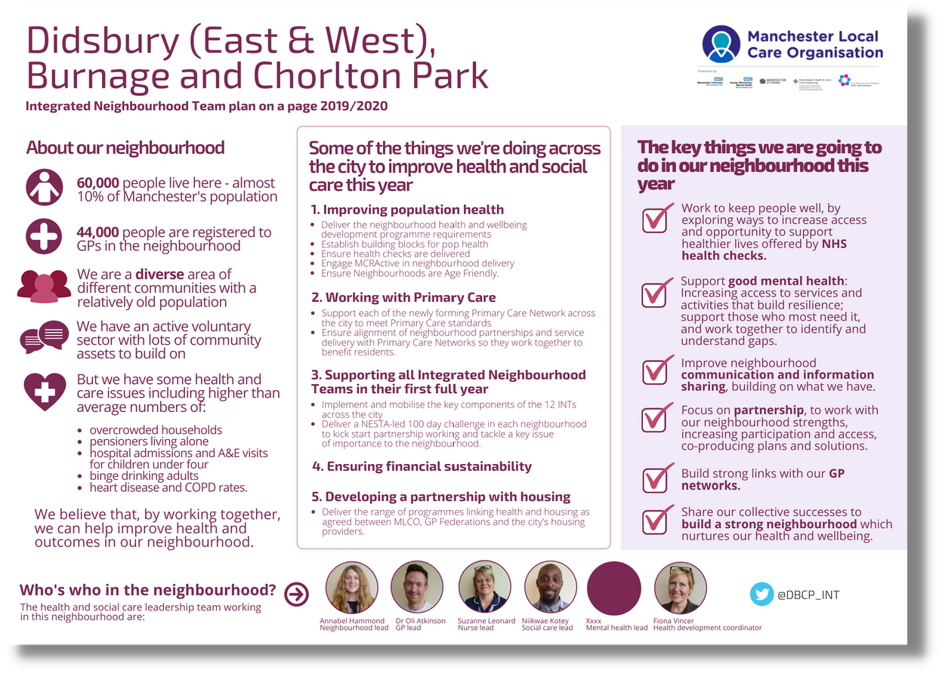
Neighbourhood planning
Each Neighbourhood has a plan developed with key stakeholders that sets out how we will work in partnership to improve key issues in their neighbourhood
Developed with partner organisations and citizens
Using neighbourhood information
Looking at joint solutions to key issues impacting health and wellbeing
Plans now being built annually.

Slide 15


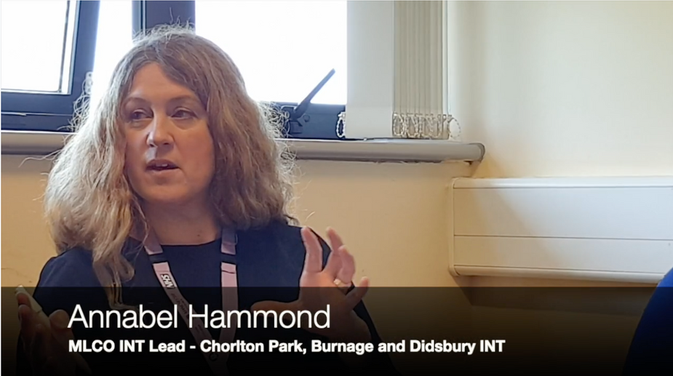


Thank you
Find out more about MLCO at:
manchesterlco.org
@mcrlco
Integration in action
Click the image on the right to view a short video about the MLCO neighbourhood approach and how health and social care now work together (opens in a new window) or visit https://vimeo.com/344291017

