Slide 1

Talent
Manchester City Council Talent Plan 2023-26

Slide 2





Our workforce strategies collectively deliver:
our workforce priorities:
Be an inclusive employer that represents the communities that we serve at all levels​
Attract, develop and retain talent
Be a thriving and healthy workforce
Develop world-class leaders and managers
Have a high performing workforce that delivers great services for our city​
to achieve our workforce vision:
Good work in a
Great City Council

Slide 3
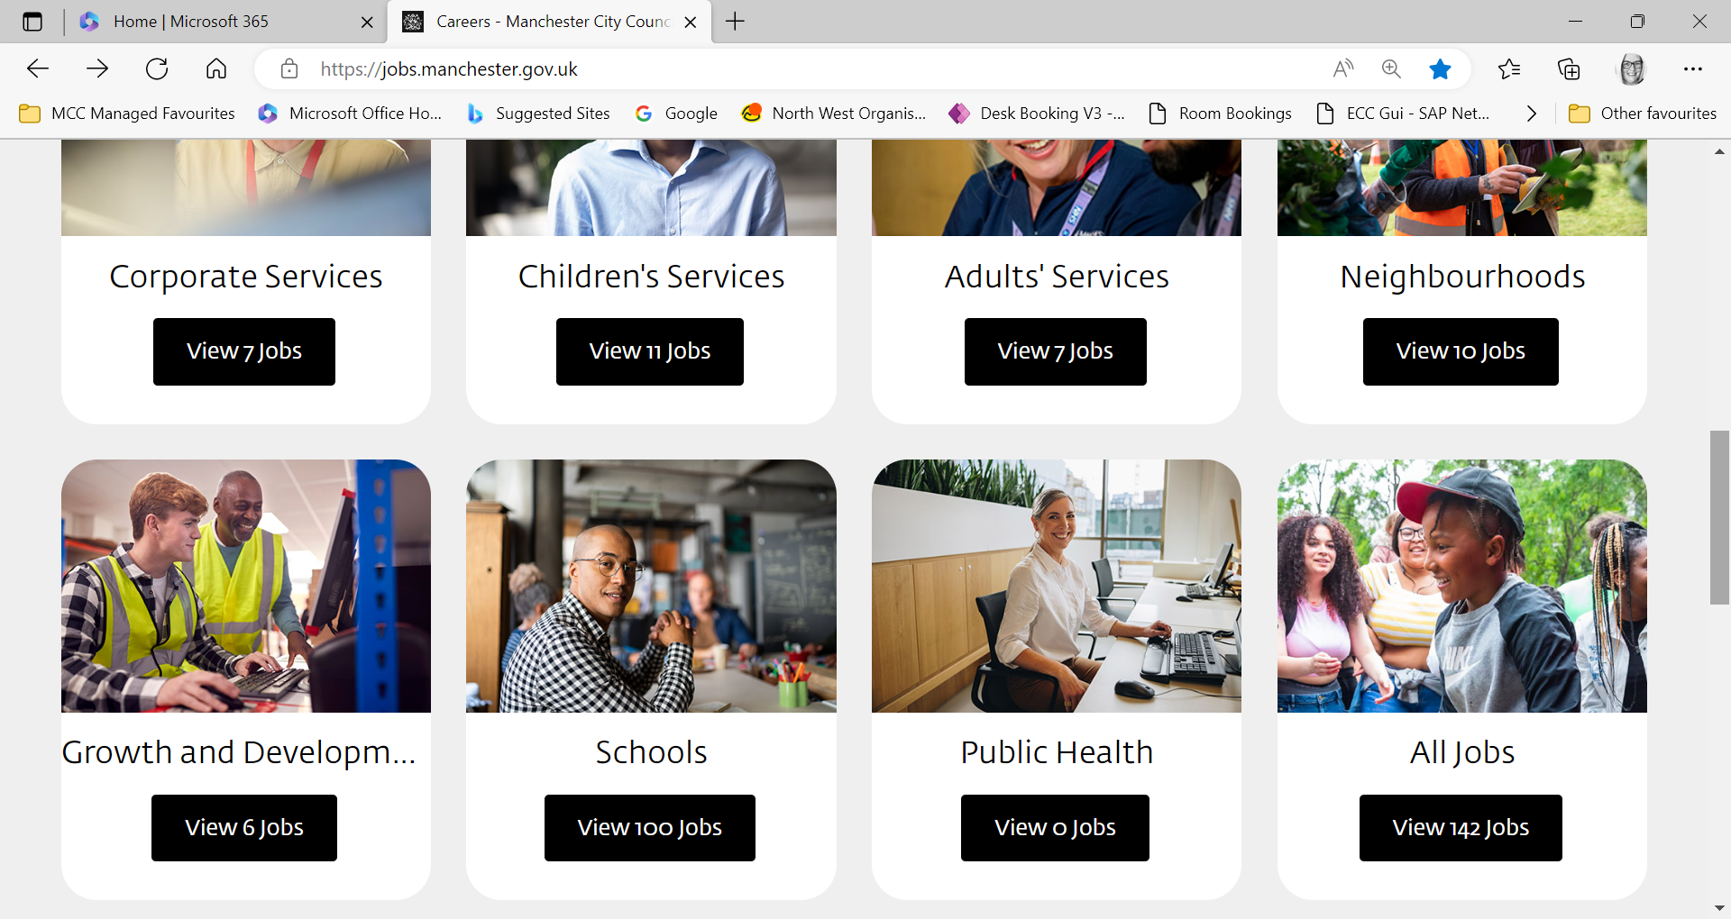
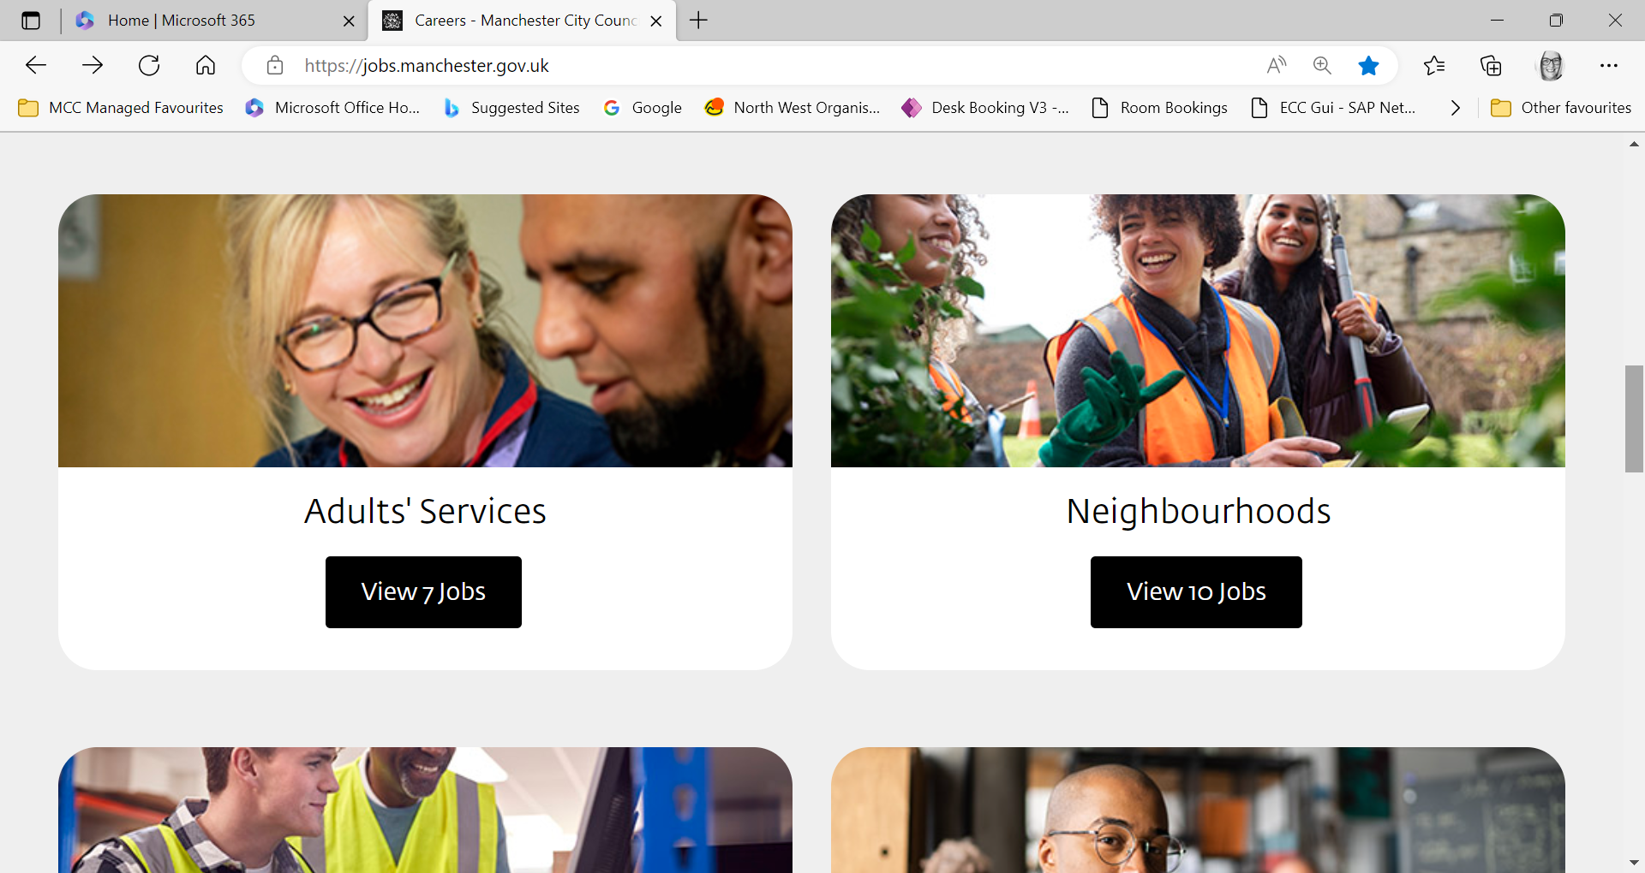


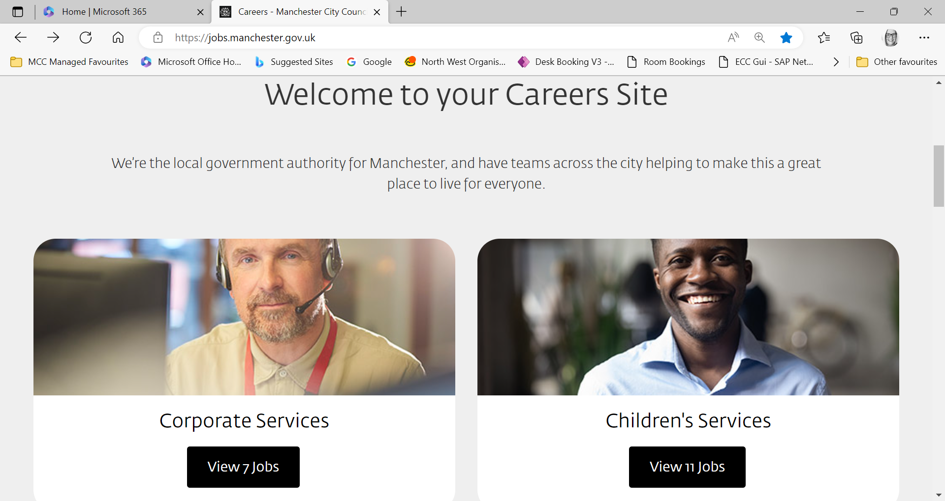


MCC Talent Plan sets out what we will do throughout 2023-26 to attract, develop and retain talent at all levels. It aims to embed talent management in the organisation so that we...
Build a diverse workforce
Are an employer of choice
Support our employees to develop the skills needed now, and in the future
Have the right people, in the right places, doing the right things

Slide 4

“…a talented and diverse workforce that performs well and makes a difference to the lives of Manchester people!”
We need this plan so that we can be
with….
happy employees
improved performance
greater innovation
more productive teams
job variety and opportunities
reduction in turnover
our reputation as an employer of choice
Notes:
Having a talent strategy with equality, diversity, and inclusion at the heart of everything we do, will help us to realise our ambitions of being in the topflight of world class cities. It will help us to make a difference to the lives of Manchester people.

Slide 5






Our Workforce
WORKFORCE DIVERSITY
AGE
47
RACE
21.8%
HEADCOUNT
7,888
TURNOVER %
11.4
VACANCY RATE %
20.64
DISABILITY
8%
FEMALE
65%
LGB OTHER
4.9%
APPRENTICESHIPS
72
APPRENTICESHIP
LEVY SPEND
61%
Notes:
24 young people 16 – 21 represents 0.3% of our workforce
Race & Disability – representation particularly at senior levels

Slide 6
Working together*, we’ll do this through:
Improve approaches to recruitment & retention
Maximise Apprenticeships, Graduates, Work Experience & Interns
Strengthen pathways into employment at MCC
Strengthen our internal pathways and progression
*it will take directorates, services, leaders and HRODT collectively to make this happen

Slide 7
Develop an attractive Employer Brand and improve how we market the Council as an Employer of Choice
Strengthen the use of social media advertising
Review our approach to recruitment to ensure that it is inclusive (inclusive recruitment)
Better use of recruitment tools and analytics
Directorates will be supported by HRODT to develop local strategies to address local challenges
Strategic approach (workforce planning) to building a talent pipeline that meets the future needs/skills of the Council.
External Talent Pool - pool of external candidates and we know their skills, knowledge, experience and can match to future vacancies.
Ensuring managers have the skills to recruit the right person with the right skills at the right time, in the best interest of the council
Strengthen our exit interview process so we have a clear understanding of reasons for leaving and respond to areas for improvement.
1.
Improved approaches to recruitment & retention

Slide 8
2.
Strengthen our relationships with
Schools, Colleges and Universities to raise awareness of the range of employment opportunities at the Council and to attract more young people
Local community groups to raise awareness of the range of employment opportunities at the Council and to attract local diverse talent.
Delivering targeted recruitment campaigns and events in communities (particularly underrepresented communities) that lead directly to jobs in the council
Review our Senior Recruitment offer to ensure our offer modern and supports the Council to attract diverse talent.
Strengthen pathways to employment at MCC

Slide 9
Develop internal career coaching and internal job fairs to drive internal movement and progression
Connecting performance and development conversations to the promotion of internal career pathways and opportunities
Developing succession planning as standard as part of wider Workforce Planning and our approach to senior recruitment
Developing and testing different approaches to Talent Pools with a view to roll out across the Council
Developing and delivering positive action support to help increase representation at different levels of the organisation.
Delivering the Leadership Pathway for Black, Asian and Minority, and disabled staff twice a year, 18 people per programme, until at least 2025
Introducing other positive action support (informed by the voice of our staff) to increase representation across other equality characteristics.
3.
Strengthening our internal pathways and progression

Slide 10
4.
Maximising Apprenticeships, Graduates, Interns and Work Experience
Ensuring we make best use of apprenticeship and graduate schemes, and provide meaningful experiences of working in the council through Internships and work experience opportunities
Increase no. of corporate graduates from 4 to 15 for 2023-25 intake*
Increase no. of apprentices from 71 to 200
Develop coordinated approach for work experience and intern placements
Set governance arrangements to monitor apprenticeship and placement recruitment and retention with directorate targets
*recruit and retain
Notes:
Set an annual apprenticeship target of 200 for 24/25
37 for the Core 24/25

Slide 11
All of this relies on having a suitably funded learning and development offer, good core skill offer, quality management and leadership inductions, accountability framework and a reward and recognition offer that is meaningful and timely.
This is picked up in the delivery of our Organisation Development Plan

Slide 12
How we’ll know if we have made a difference We will monitor the impact of this plan through improved workforce intelligence
We’ll measure:
Diversity of the workforce at all levels/grades
Vacancy rate.
Number of apprenticeships, graduates, interns and work experience
Internal progression levels
Internal recruitment figures
External recruitment figures
Retention and Turnover levels
Staff survey
Feedback from candidates.
Where we’ll notice the difference:
Increased representation at all levels.
Increase the number of recruitment applications that we receive (and increase the number of applications that we shortlisted)
Improved visibility and awareness of the Council as an employer of choice
Reduced vacancies and turnover (particularly hard to fill roles)
Increased retention
Increased internal progression

Slide 13
If you have any questions about Talent please email
Talent@manchester.gov.uk

