Slide 1
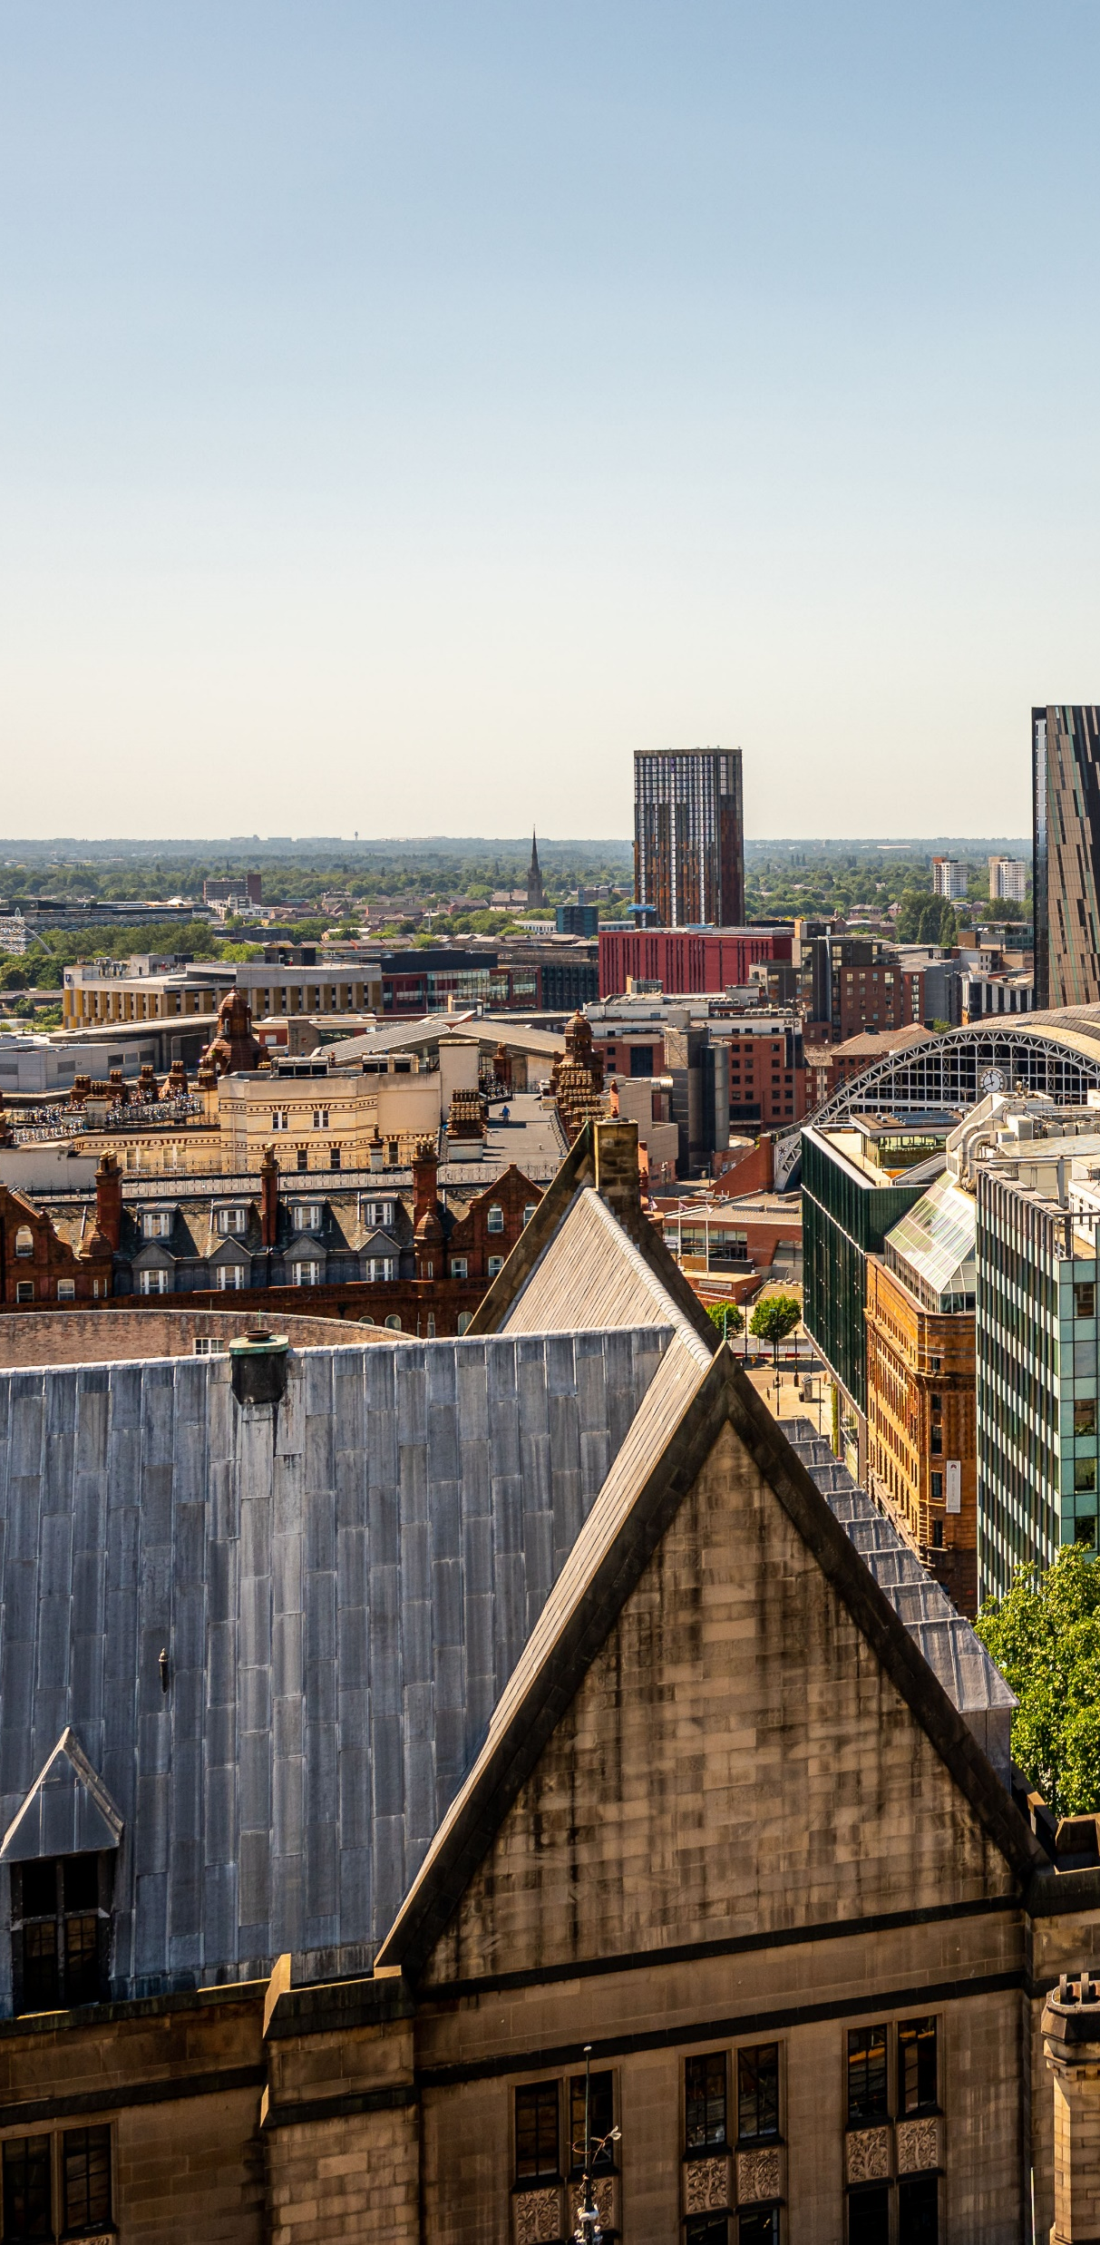


Good work in a
Great City Council
Manchester City Council Workforce Strategy 2023-26

Slide 2








Manchester
City Council
We recognise that the local government workforce continues to face challenges in terms of reduced government funding, increased pressure on services, delivering more with less combined with talent and skills shortages and challenges with competing with the private sector. This makes the challenge even harder, however, we are confident that our bold and ambitious strategy will ensure that the Council is an employer of choice and has the right capacity, capability and diversity to deliver for the residents of Manchester.
Our Workforce strategy is an ambitious and dynamic plan with five strategic priorities aimed at building a talented, diverse, and thriving workforce capable of delivering excellent services and helping the Council meet its strategic goals. These priorities have been developed through understanding the challenges and opportunities that the Council faces, working with our Directorates to understand local priorities through annual workforce planning, understanding our workforce intelligence and staff survey findings and being clear about what we want the Council to look like in the future.
It is important that our strategy also addresses the variety of factors that influence the Council and our people. These include changing priorities, increasing demands on our services, decreases in funding, new ways of working, emerging digital skills and technology, changes in the demography of residents and amendments to legislation which all require us to provide new or different services.
At Manchester City Council, we take pride in our unique approach to local government, reflecting our city’s renowned diversity, creativity, culture, and passion.
As one of the city’s largest employers, with over 8,000 staff who deliver more than 100 services, it’s crucial that we have a workforce strategy which ensures we have the right people with the right skills in the right place at the right time to serve Manchester’s residents effectively.
The Our Manchester Strategy sets out what residents, communities and businesses want the future of Manchester to look like, and the MCC Corporate Plan details the steps we need to take as an organisation to help in achieving this vision.
Our people are our greatest asset, essential to realizing our strategic priorities and achieving our objectives. We celebrate the dedication, hard work, and talent of our staff, who have been instrumental in driving the Council’s progress and improvements.

Slide 3
Our vision is for good work in a great city council
GOOD WORK
Delivering high quality services for residents and communities
Fairness and equity​
Health and well being​
Meeting outcomes
Employee voice heard​
Nature of work and supervision (autonomy, job design, good management)​
Cohesion and psychological safety (teamwork)​
Work/life balance and integration​
  GREAT CITY COUNCIL
  Representative of the communities we serve at all levels
  Our Manchester Strategy and behaviours
  Culture – trust and accountability
  Our reputation as an employer

Slide 4





Values and Behaviours
The “Our Manchester” behaviours are a set of principles designed to guide how people work and interact within the city.
  We take time to listen and understand: Emphasizing the importance of active listening and empathy.
  We work together and trust each other: Promoting teamwork and mutual trust.
  We show that we value our differences and treat people fairly: Encouraging inclusivity and fairness.
  We own it and are not afraid to try new things: Creating a culture of accountability and innovation.
  We are proud and passionate about Manchester: Highlighting pride and enthusiasm for the city.

Slide 5
Workforce Strategy
The Workforce Strategy 2023-26 sets out our overall workforce vision for the next three years, providing strategic direction and clear outcomes that we are aiming to achieve. It is the ‘golden thread’ which aligns our workforce to the delivery of the Corporate Plan, Our Manchester Strategy and the residents of Manchester.
The five strategic priorities within the workforce strategy are:
  Attract, develop and retain diverse talent
  Be an inclusive employer that represents the communities that we serve at all levels
  Develop world-class leaders and managers
  High performing workforce that delivers great services for our city
  Be a healthy, engaged and thriving workforce.
Whilst the workforce strategy sets the overall strategic priorities for the workforce; the priorities are collectively delivered through the following plans/strategies:
  Talent Plan
  Workforce Equalities Strategy
  Organisation Development Plan
  Health and Wellbeing Strategy

Slide 6




Our workforce plans collectively deliver:
our workforce priorities:
Be an inclusive employer that represents the communities that we serve at all levels​
Attract, develop and retain talent
Be a thriving and healthy workforce
Develop world-class leaders and managers
Have a high performing workforce that delivers great services for our city​
to achieve our workforce vision:
Good work in a
Great City Council

Slide 7
Workforce Plans and their priorities

Slide 8
Health & Wellbeing Plan
PROMOTE AND ENCOURAGE GOOD MENTAL HEALTH AND WELLBEING - Ensure staff and managers have the knowledge, skills and tools to support having good mental health and wellbeing and that everyone feels that they can talk openly about stress and Mental Health
EMPOWER STAFF TO MAKE GOOD PHYSICAL HEALTH AND LIFESTYLE CHOICES - Empower our workforce to engage in healthy lifestyle choices by promoting physical activities, healthy eating and healthy lifestyles.
EMBED GOOD WELLBEING PRACTICES IN OUR LEADERSHIP - Support leaders (at all levels) to champion health and wellbeing and promote and prioritise the health and wellbeing of their teams and services.
STRENGTHEN HEALTH & WELLBEING COMMUNICATIONS AND ENGAGEMENT - Develop first-class communications and engagement, ensuring everyone is connected to staying safe and well, and that they have a voice that is heard and reflected in decision making.
GROW OUR INCLUSIVE AND ACCESSIBLE FINANCIAL WELLBEING OFFER - Continue to strengthen our financial wellbeing offer which promotes financial literacy, provides access to affordable borrowing and advances and respond directly to the cost-of-living crisis.
HEALTHY AND INCLUSIVE WORKPLACE - Ensure that staff work in environments that promote wellbeing, which are open and inclusive, with a good work-life balance and a sense of role fulfillment.
To create a healthy and thriving workforce by prioritising and promoting the health and wellbeing of staff
Promoting and supporting the health, safety and wellbeing of staff is a priority for the council. The Health and Wellbeing Plan sets out how we will improve workplace wellbeing leading to increased resilience, better employee engagement, reduced sickness absence, and higher performance and productivity.

Slide 9

The Workforce Equality Diversity & Inclusion Plan
INCLUSIVE AND ACCOUNTABLE LEADERSHIP Leaders are role models for inclusion and provide visible, accountable and inclusive leadership which supports the Council to advancing workplace equality, diversity and inclusion.
BEING A GOOD LINE MANAGER Ensure our line managers have the knowledge, skills and confidence to proactively champion equality, diversity and inclusion.
RACE AND ANTI-RACISM Demonstrating our committment to becoming an intentionally anti-racist employer that proactively tackles racism in our policies, practices, systems and structures.. Advance race equality in the workplace and recruit and develop a workforce better reflects the communities that we serve all levels.
DISABILITY AND NEURO-DIVERSITY Committed to attracting, developing and retaining Disabled employees and employees with long-term health conditions and ensuring our workplace is neuroinclusive, accessible and supports people to thrive.
ATTRACTING, DEVELOPING AND RETAINING DIVERSE TALENT Creating a talented and diverse workforce that performs well, better reflects the communities that we serve at all levels and makes a difference to the lives of Manchester people
EQUITABLE AND INCLUSIVE WORKPLACE Committed to becoming an inclusive employer and to ensuring the Council is an inclusive employer which is reinforced by our culture, engagement policies, processes, systems and training.
For the Council to fully reflect the diversity of the communities that we serve at all levels and to be a place where our workforce can be themselves and thrive.
This plan sets out the importance of inclusive leadership and management, ensuring our diverse employees are protected from discrimination in any form, have access to development and progression opportunities, are treated with respect, have good and fulfilling work to do and can bring their whole selves to work

Slide 10

MCC Talent
Plan 2026
IMPROVE APPROACHES TO RECRUITMENT AND RETENTION – Develop an inclusive recruitment process to attract, develop, and retain a diverse workforce. Enhance the Employer Brand, creatively reach diverse communities, support managers in recruiting effectively, and strategically build a talent pipeline to meet the Council’s future needs.
STRENGTHEN PATHWAYS INTO EMPLOYMENT AT MANCHESTER CITY COUNCIL - Strengthen employment pathways to reflect our communities by partnering with educational institutions, engaging local groups, delivering targeted recruitment campaigns, and reviewing senior recruitment to attract diverse talent.
STRENGTHEN OUR INTERNAL PATHWAYS AND PROGRESSION - Create pathways for internal progression through career coaching, job fairs, and positive action support. Link performance discussions to career pathways and integrate succession planning into workforce and senior recruitment strategies
MAXIMISE APPRENTICESHIPS, GRADUATES, WORK EXPERIENCE AND INTERNSHIPS - Ensuring we make best use of apprenticeship and graduate schemes, and provide meaningful experiences of working in the council through Internships and work experience opportunities
To create a talented and diverse workforce that performs well and makes a difference to the lives of Manchester people
The MCC Talent Plan recognises that everyone has talent, and for the organisation to be successful we need to maximise and strengthen the opportunities for talent to grow.

Slide 11
Organisation Development Plan II
LEADERSHIP - Supporting leaders now and for the future through a new leadership framework that defines what it means to lead in this organisation, with clear expectations, support and guidance.
DECISION & RISK - Renewed focus of supporting people to make the right decisions through informed thinking and risk tolerance, and ensuring accountability is at the right level.
PERFORMANCE DEVELOPMENT - Building on the first iteration of performance and development to overcome some of the challenges around time, prioritisation and accountability at all levels.
RECOGNITION AND STAFF VOICE - Developing a compassionate, individualised approach to recognition that is consistent and aligned to staff voice, positive experiences of work and our organisational purpose
To improve the effectiveness and performance of the organisation by aligning processes and systems, with culture of the organisation
The plan sets out areas where intervention is required to create change and to help us maximise performance and deliver:
Our Manchester Strategy (2025-35)
Public Service Reform
Corporate Plan
Our Transformation

Slide 12
How we will know we are making a difference

Slide 13
We will see increased motivation across all our staff team, we will know this through: | improved engagement rates in staff survey and corporate engagement initiatives improved employee satisfaction as reported in the annual staff survey sustained improvement in key employee performance metrics | Staff survey response rate Staff Survey in ENPS Reduction in sickness absence Reduction in upheld number of discrimination cases
As an employer of choice we will attract and retain a diversity of talented people, we will know this by: | improved ability to attract, recruit, retain talent thus becoming an employer of choice increased diversity in the organisation through career and succession planning, and the end-to-end recruitment process | Stablised Turnover rate/Turnover in line with national avg Internal progression Increased internal progression of Black, Asian & Minority Ethnic staff and disabled staff Increase in diversity in race and disability
The experience of delivering our work will become more efficient and effective, we will know this through: | Improved relationships between staff and managers all staff having access to the tools, knowledge and skills to be successful at work and resilient to change, with supportive managers performance being well managed, with all staff having up-to date development plans and timely, constructive 121s | Increase in staff having regular 121s Decrease in upheld manager related Employee Disputes Increase in staff feeling supported by their line managers
Our leadership and management individually and collectively support our organisation to be successful, we will know this because: | managers have the support they need to be high-performing managers, who understand and are fully supported in their role as a line manager we have greater diversity represented across our leadership and management roles leadership is recognised and celebrated at all levels of the organisation | Increase in managers feeling supported by their line managers Increased diversity in senior leadership roles Improved diversity in leadership engagement

Slide 14
October 2024

