Slide 1


Our Manchester
Organisation Development Plan II

Slide 2
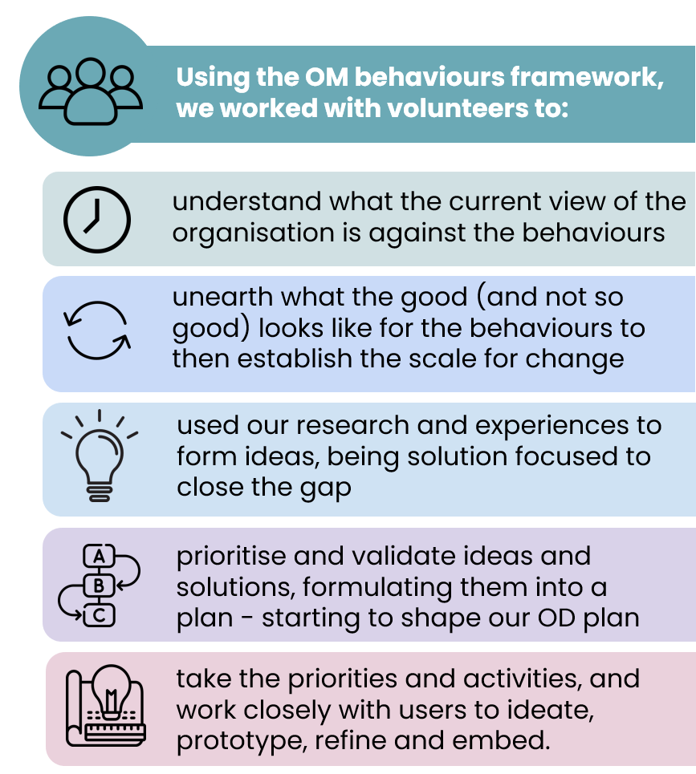
Introduction
Our first Organisation Development Plan (OD Plan) was developed in 2021, building on five years of work to transform the culture of the organisation through the embedding of the Our Manchester behaviours.
Using a user-centred approach to service design, meant staff and their experiences were part of the process every step of the way, keeping the work grounded and the results authentic and accessible.
We didn’t start with a blank page, we built on what we already knew about the organisation, and what we learnt interlinked with other programmes of work.
Two years on, it’s time to refresh the OD Plan to reflect how the organisation looks and feels now, and to tackle what remain as some of our more complex workforce challenges.

Slide 3
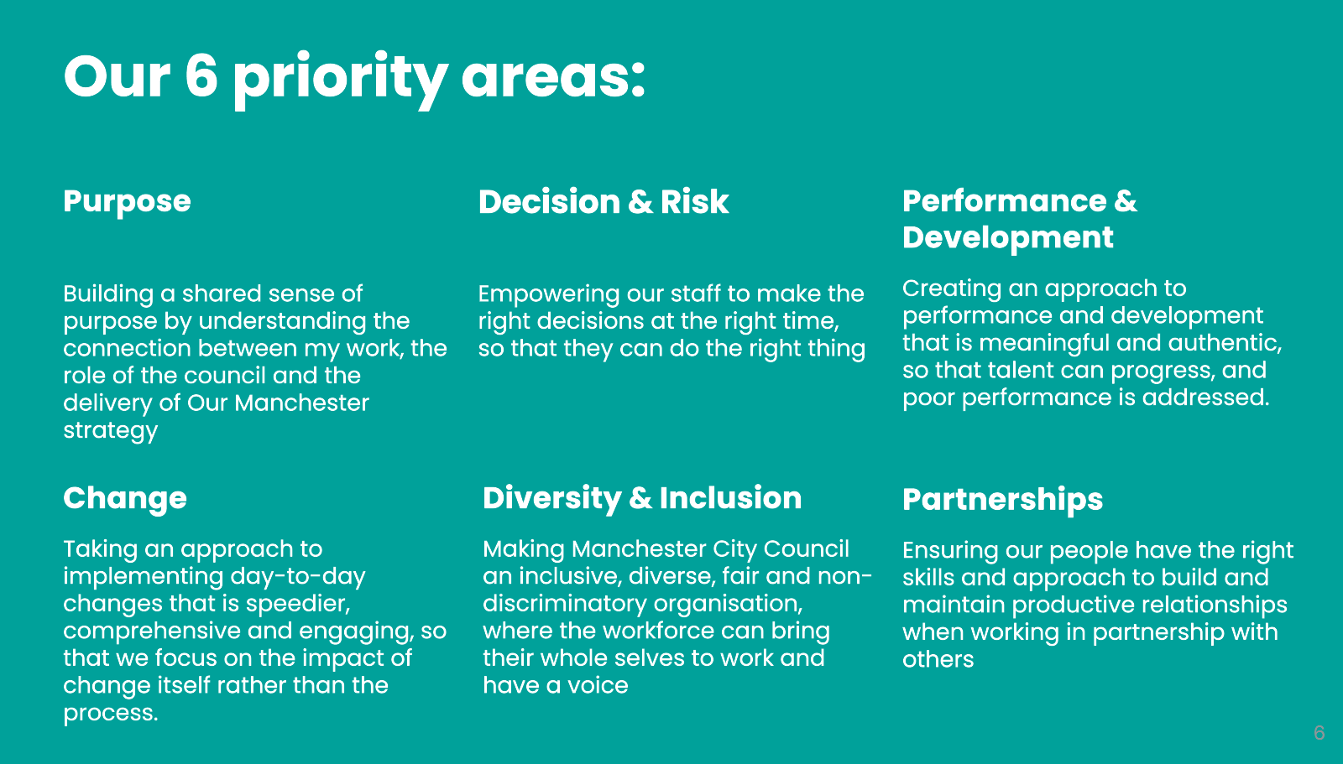
The first OD Plan (2021-23)
The first OD Plan built on how we hardwire the Our Manchester Behaviours into everything we do.
At the time the plan was developed, the organisation was without the Workforce Equality Strategy, the Talent Plan or a current Health and Wellbeing Strategy. Therefore, the OD plan was trying to ‘fill the gap’ through six priority areas.
The priorities and subsequent activities could only scratch the surface of what was needed. When the work felt harder or unable to be progressed, it was partly because the organisation just wasn’t ready for that change.
Where we could, we reconsidered our approach and for some, we paused to re-evalaute what we were trying to do and consider whether more in-depth work was needed.

Slide 4
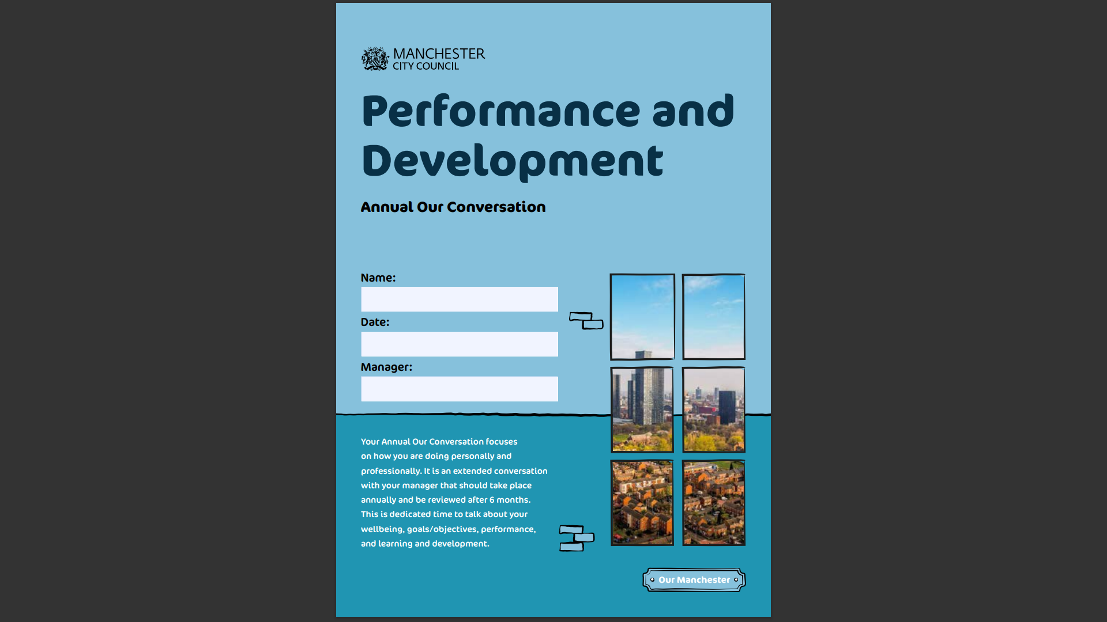
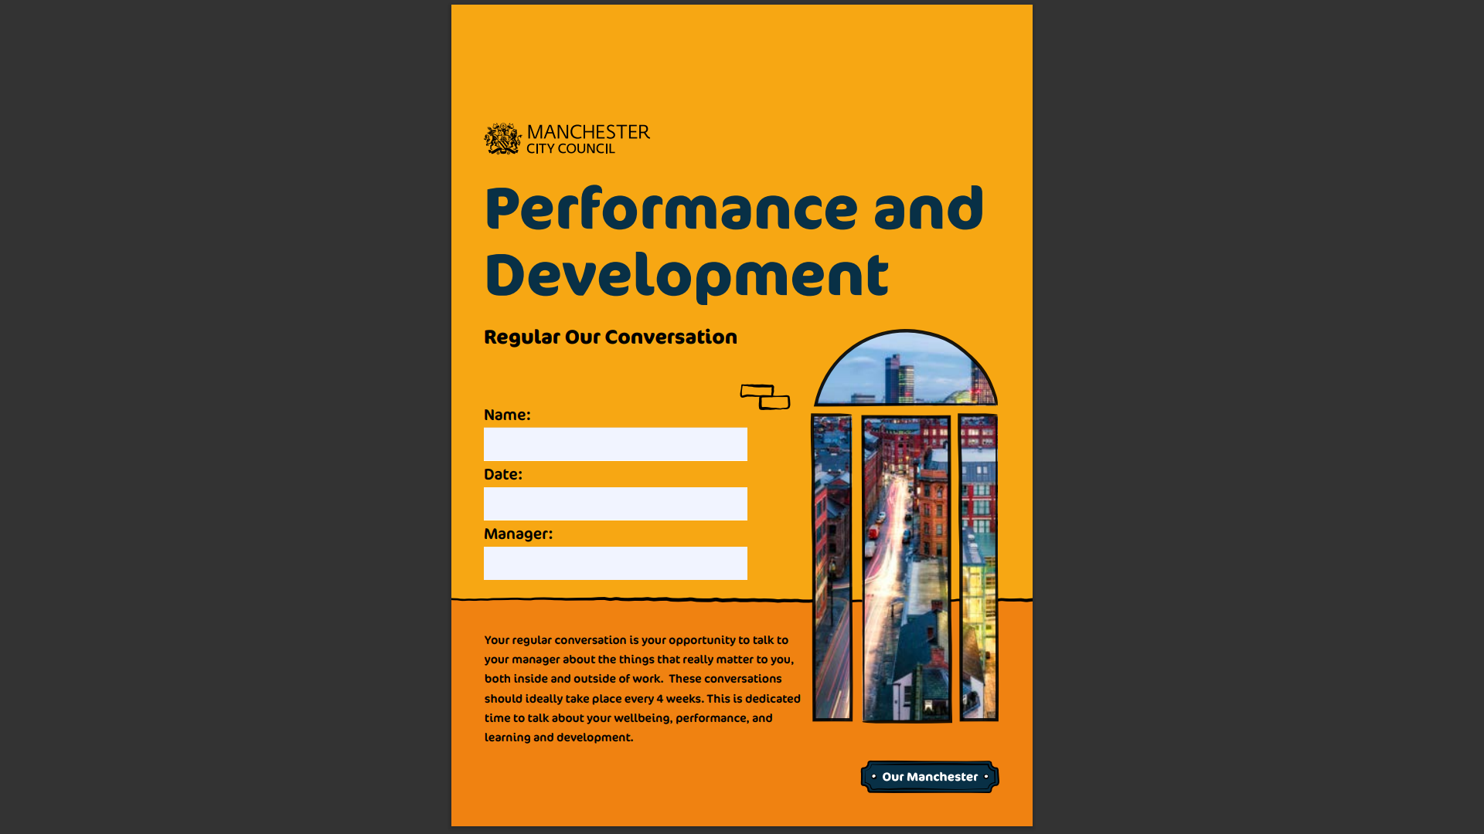
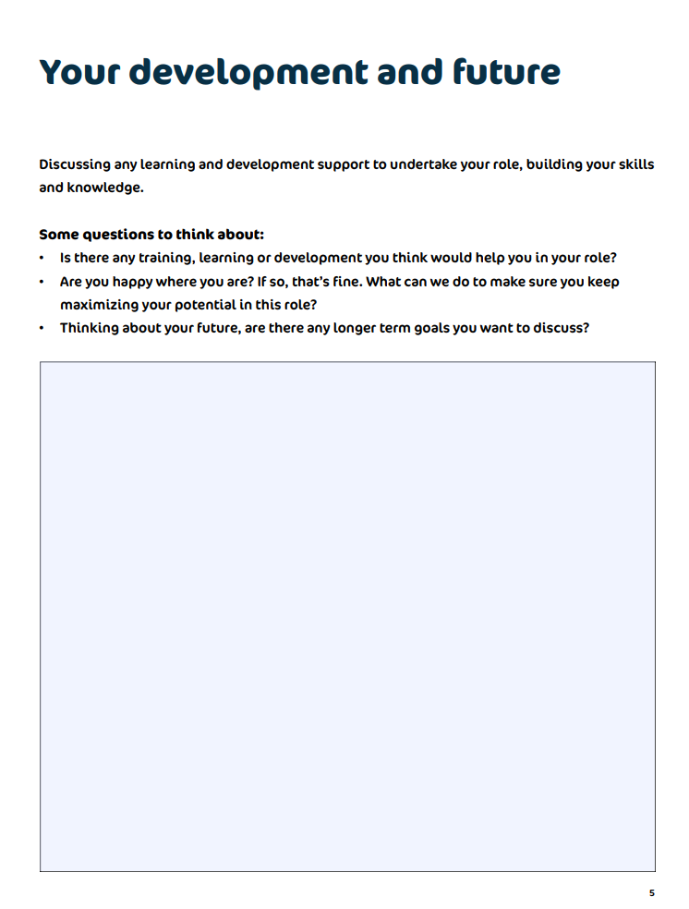
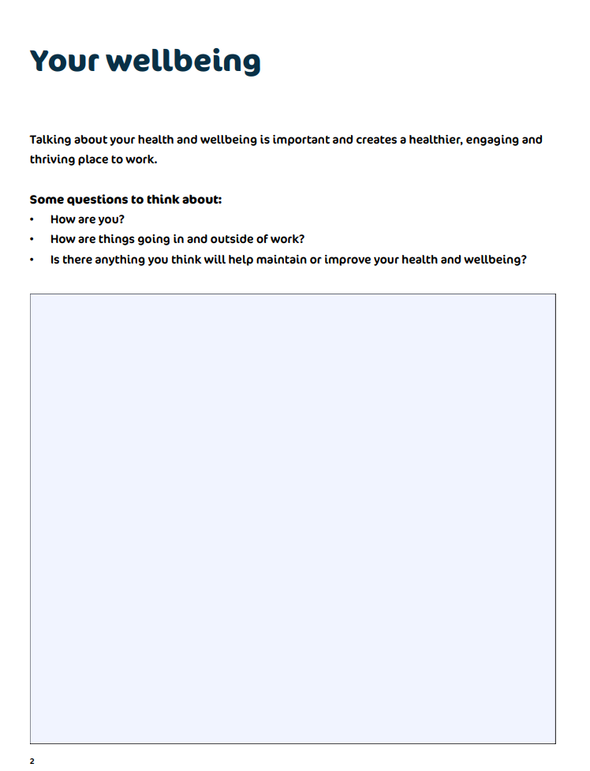
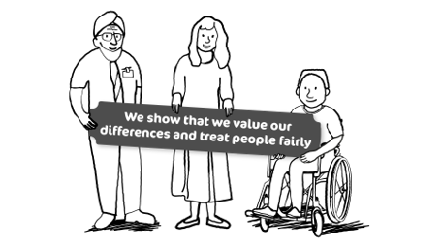
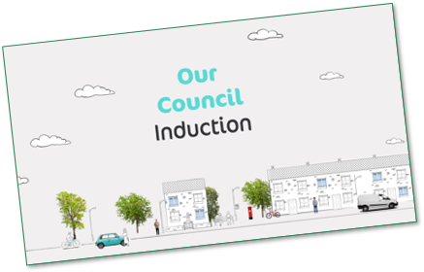
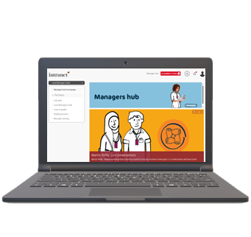
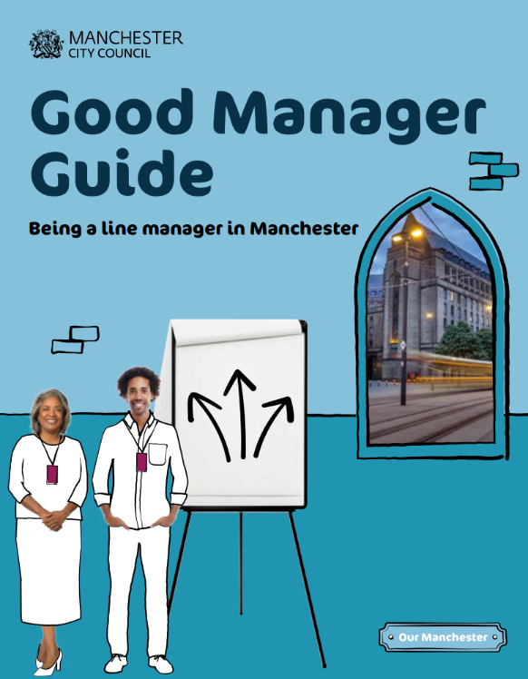
OD Plan (2021-23) highlights
What we learnt early on was that we needed to get the basics right in a way that is seamless and coordinated.
Some priorities and activities had greater momentum than others. This happened when the work felt familiar or when the work was aligned to other programmes of work.
Some key successes include:
improved early experiences for staff from recruitment, onboarding, through to the reintroduction of the corporate induction.
a new fifth behaviour is a clear statement and a call to action for the organisation to be fair and non-discriminatory
improved employee experiences reported in the annual staff survey
enriched role of staff voice in change programmes
an improved approach to performance development with all staff having regular, meaningful one-to-ones where they come away knowing what they need to do, what they’re good at and not as good at.
greater support for managers with clear expectations for line managers.

Slide 5
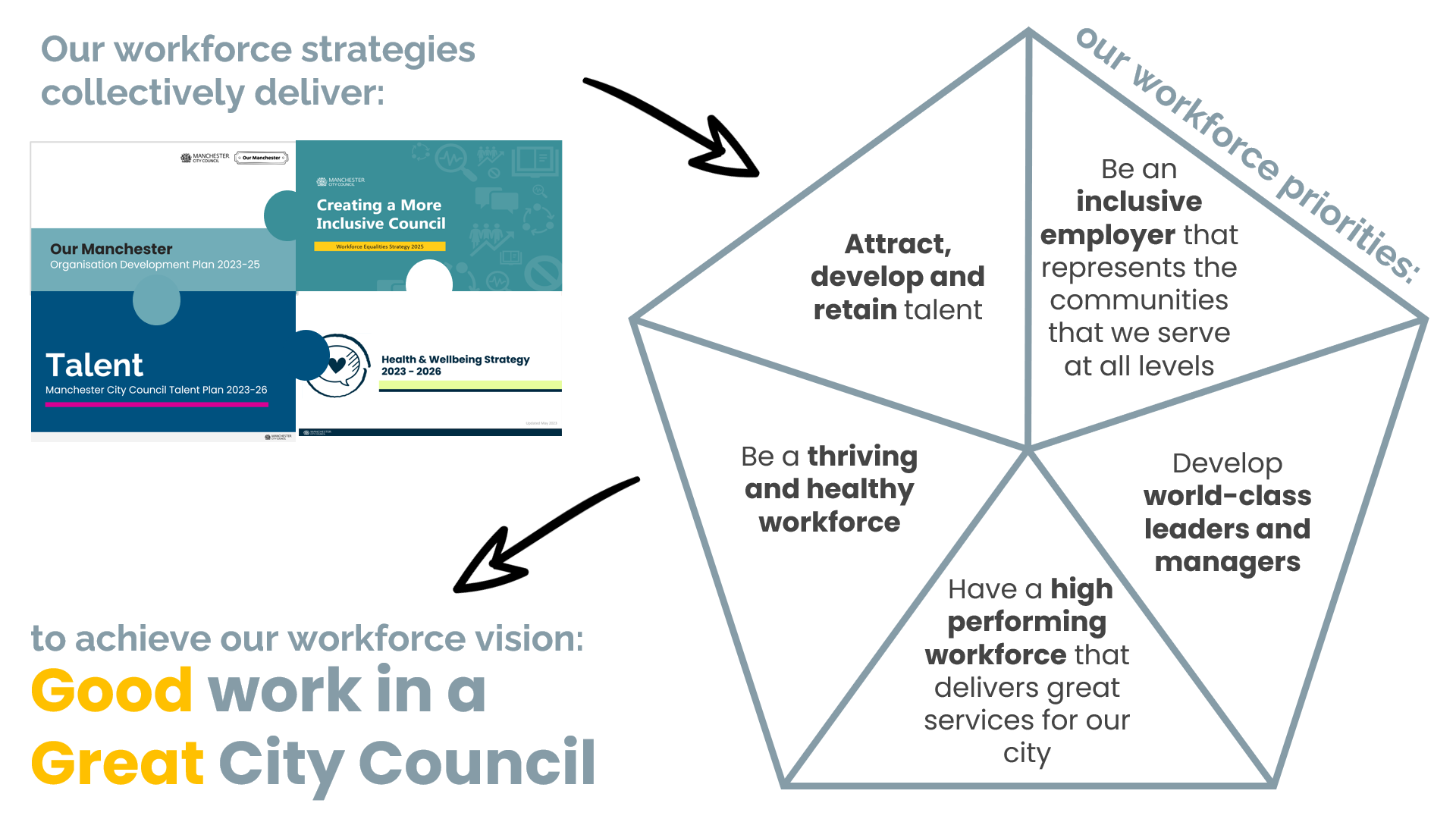
Where we are now
Our workforce plan
The new OD Plan forms part of the workforce plan and supports the delivery of the other workforce strategies – the Workforce Equality Strategy, Talent Plan and the Health and Wellbeing Strategy.
“Our workforce plans support our workforce ambition”

Slide 6
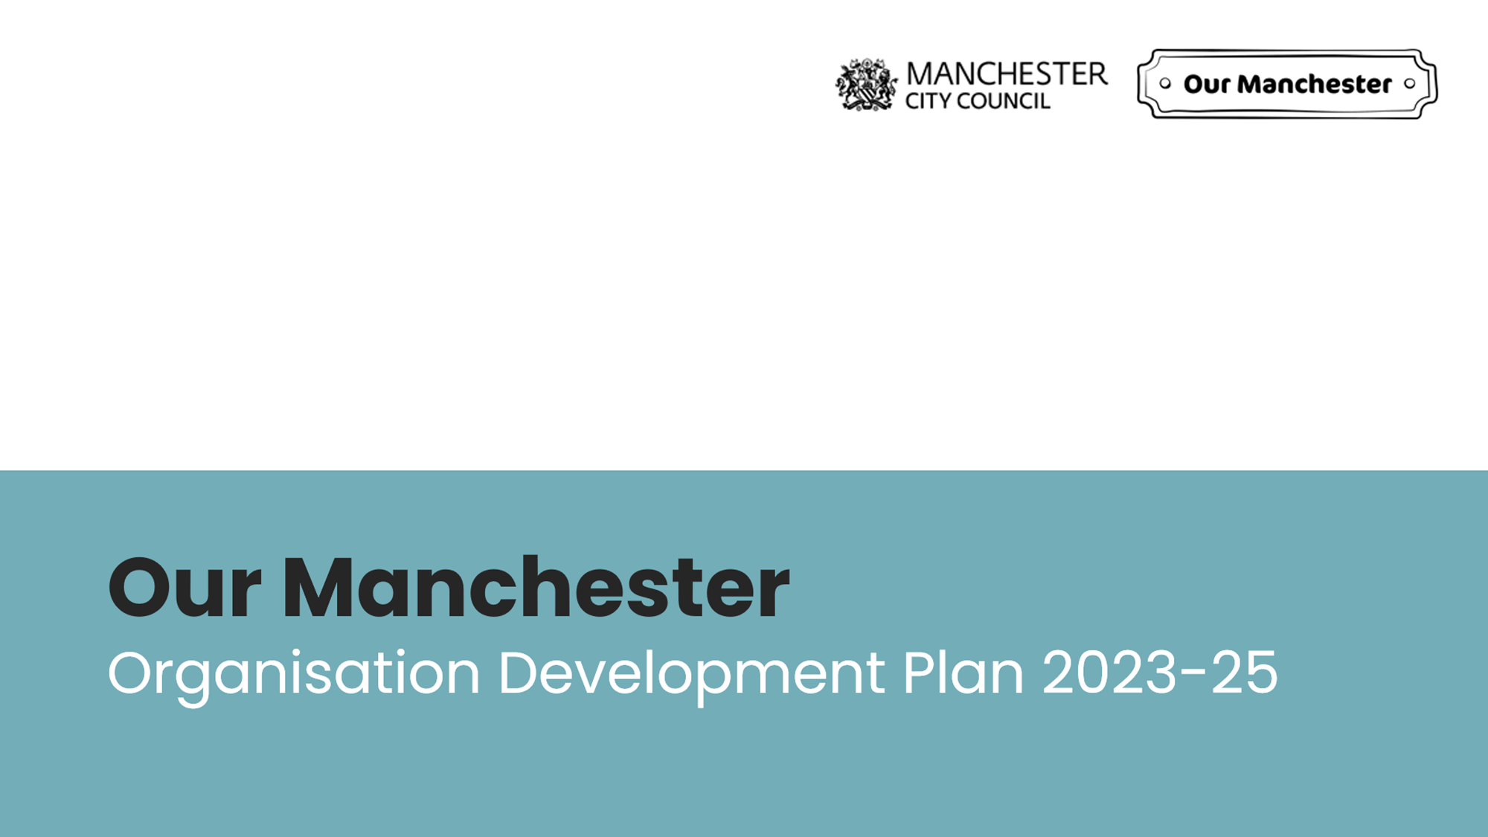

Purpose of the OD plan is improving the effectiveness and performance of the organisation by aligning processes and systems, with culture of the organisation.
The plan sets out areas where intervention is required to create change – to help us to deliver:
Public Service Reform
Corporate Plan
Future Shape (Internal Digital transformation)
Our Manchester Strategy (2025-35)
Efficiencies and savings by maximising performance
We will deliver:
The basics – good universal services
Early intervention – preventing problems down the line
Tackle complex problems together.

Slide 7
 | OD Plan | Workforce Equality Strategy | Talent Plan | Health & Wellbeing Strategy
Attract, develop and retain talent |  | x | x
Be an inclusive employer that represents the communities that we serve at all levels |  | x | x | x
Develop world-class leaders and managers | x |  | x
Have a high performing workforce that delivers great services for our city | x |  | x | x
Be a thriving and healthy workforce | x | x |  | x
How the plan contributes to our workforce priorities

Slide 8
The refreshed OD Plan…
Will take a deeper dive into the culture of the organisation tackling the challenges and getting closer to the root causes. We will reflect on the past, and present, to help enable change and make sure the organisation is fit for the future.
Will keep staff voice and experiences firmly at the centre of the plan with design-thinking continuing to be the default approach for the work. Opportunities will be sort for where the OD Plan can elevate and add value to other strategies and programmes of work and share in the wealth.
Will not be a programme of business-as-usual activity, or the sole work of the Organisation Development Team. It is about working together to get under the skin of some of our biggest issues, asking why (and why again) to try to find the right solutions.
This OD plan is about...
enabling change and making sure
the organisation is fit for the future.

Slide 9
Our four priority areas for 2023/25:
Leadership
Supporting leaders now and for the future through a new leadership framework that defines what it means to lead in this organisation, with clear expectations, support and guidance.
Performance Development
Building on the first iteration of performance and development to overcome some of the challenges around time, prioritisation and accountability at all levels.
Decision & Risk
Renewed focus of supporting people to make the right decisions through informed thinking and risk tolerance, and ensuring accountability is at the right level.
Recognition & Staff Voice
Developing a compassionate, individualised approach to recognition that is consistent and aligned to staff voice, positive experiences of work and our organisational purpose.

Slide 10
Leadership
Supporting leaders now and for the future through a new leadership framework that defines what it means to lead in this organisation, with clear expectations, support and guidance.
Develop a skills, behaviours and accountability framework that’s tailored to leading in Manchester with an emphasis on cultural competence, understanding place and data informed decision-making.
Review and develop our programme of leadership engagement with a focus on collective leadership for the residents and communities of Manchester.
Nurture future leaders with a commitment to growing our own talent (linked to the Talent Plan).

Slide 11
Performance development
Building on the first iteration of performance and development to overcome some of the challenges around time, prioritisation and accountability at all levels.
Understand the internal and external factors that affect the ability of someone to manage and be managed well.
Support managers with early intervention and prevention so that issues are addressed early on, and problems are prevented further down the line.
Build accountability at all levels so that good performance development is embedded into the organisation.

Slide 12
Decision and risk
Renewed focus of supporting people to make the right decisions through informed thinking and risk tolerance, and ensuring accountability is at the right level.
Develop decision-making principles and an offer of support to help people to feel confident in making good decisions.
Ensure that systems and processes support good decision-making
Build accountability and more effective levels of decision-making and risk appetite.

Slide 13
Recognition and Staff Voice
Developing a compassionate, individualised approach to recognition that is consistent and aligned to staff voice, positive experiences of work and our organisational purpose.
Understand the role of recognition in building a sense of purpose and belonging in the organisation, and the feeling of psychological safety.
Understand the connection between performance development and reward and recognition, building on Our Conversation and how good conversations support meaningful relationships and the ability to give and receive feedback.
Continue to build staff voice into everything we do through listening and action, whilst also managing expectations by being up front about what we can and can’t do.

Slide 14
What is the impact of the plan?
Over time, we’d expect the see the following impact as a result of the OD plan
The experience of delivering our work will become more efficient and effective, we will know this through:
quicker and more efficient decision making that is evidence based and takes a positive approach to risk
all staff having access to the tools, knowledge and skills to be successful at work and resilient to change, with supportive managers
performance being well managed, with all staff having up-to date development plans and timely, constructive 121s
Our leadership and management individually and collectively support our organisation to be successful, we will know this because:
managers have the support they need to be high-performing managers, who understand and are fully supported in their role as a line manager
we have Greater diversity represented across our leadership and management roles
leadership is recognised and celebrated at all levels of the organisation
We will see increased motivation across all our staff team, we will know this through:
improved engagement rates in staff survey and corporate engagement initiatives
improved employee experience as reported in the annual staff survey
sustained improvement in key employee performance metrics such as sickness absence, grievance and disciplinary
As an employer of choice we will attract and retain a diversity of talented people, we will know this by:
improved ability to attract, recruit, retain talent thus becoming an employer of choice
increased diversity in the organisation through career and succession planning, and the end-to-end recruitment process

